Slide 1
21CSE354T – FULL STACK WEB DEVELOPMENT UNIT 3
SQL, JDBC Overview

Slide 2
SQL Overview: Basics of SQL: Data basics, Retrieval: Basic Selection, Joins, Set Queries: UNION, INTERSECT, and EXCEPT, Subqueries, Modifying Data: Insert, Delete, Update, Creating, Deleting, and Altering
Tables,

Slide 3
Basics of SQL: SQL
The most widely used commercial language
SQL is NOT a Turing machine equivalent language
To be able to compute complex functions SQL is usually embedded in some higher-level language
Application programs generally access databases through one of
Language extensions to allow embedded SQL
Application program interface (e.g., ODBC/JDBC) which allow SQL queries to be sent to a database
Notes:
‹#›

Slide 4
Data Definition Language (DDL)
Specification notation for defining the database schema
Example: create table instructor ( ID char(5), name varchar(20), dept_name varchar(20), salary numeric(8,2))
DDL compiler generates a set of table templates stored in a data dictionary
Data dictionary contains metadata (i.e., data about data)
Database schema
Integrity constraints
Primary key (ID uniquely identifies instructors)
Authorization
Who can access what
Notes:
‹#›

Slide 5
Data Manipulation Language (DML)
Language for accessing and manipulating the data organized by the appropriate data model
DML also known as query language
Two classes of languages
Pure – used for proving properties about computational power and for optimization
Relational Algebra
Tuple relational calculus
Domain relational calculus
Commercial – used in commercial systems
SQL is the most widely used commercial language
Notes:
‹#›

Slide 6
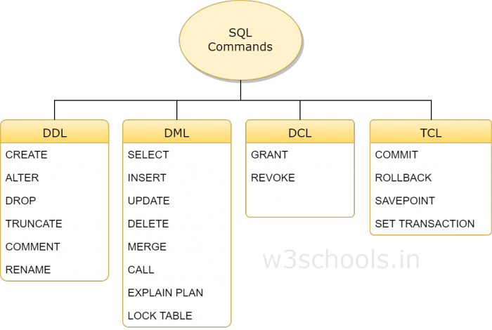
Basics of SQL
DDL is Data Definition Language statements
Some examples
CREATE - to create objects in the database
ALTER - alters the structure of the database
DROP - delete objects from the database
TRUNCATE - remove all records from a table
COMMENT - add comments to the data dictionary

Slide 7
DML is Data Manipulation Language statements
Some examples:
SELECT - retrieve data from the a database
INSERT - insert data into a table
UPDATE - updates existing data within a table
DELETE - deletes all records from a table, the space for the records remain
CALL - call a PL/SQL or Java subprogram
EXPLAIN PLAN - explain access path to data
LOCK TABLE - control concurrency

Slide 8
TCL(Transaction Control Language) is a DML
COMMIT - save work done
SAVEPOINT - identify a point in a transaction to which you can later roll back
ROLLBACK - restore database to original since the last COMMIT
SET TRANSACTION - Change transaction options like what rollback segment to use
DCL is Data Control Language statements
Some examples:
GRANT - gives user's access privileges to database
REVOKE - withdraw access privileges given with the GRANT command

Slide 9
Retrieval: Basic Selection Basic Query Structure
A typical SQL query has the form: select A₁, A₂, ..., A_{n} from r₁, r₂, ..., r_{m} where P
A_{i} represents an attribute
R_{i} represents a relation
P is a predicate.
The result of an SQL query is a relation.
Notes:
2

Slide 10
The select Clause
The select clause lists the attributes desired in the result of a query
corresponds to the projection operation of the relational algebra
Example: find the names of all instructors: select name from instructor
NOTE: SQL names are case insensitive (i.e., you may use upper- or lower-case letters.)
E.g., Name ≡ NAME ≡ name
Some people use upper case wherever we use bold font.
Notes:
3

Slide 11
The select Clause (Cont.)
SQL allows duplicates in relations as well as in query results.
To force the elimination of duplicates, insert the keyword distinct after select.
Find the department names of all instructors, and remove duplicates
select distinct dept_name from instructor
The keyword all specifies that duplicates should not be removed.
select all dept_name from instructor
Notes:
4

Slide 12
The select Clause (Cont.)
An asterisk in the select clause denotes “all attributes”
select * from instructor
An attribute can be a literal with no from clause
select ‘437’
Results is a table with one column and a single row with value “437”
Can give the column a name using:
select ‘437’ as FOO
An attribute can be a literal with from clause
select ‘A’ from instructor
Result is a table with one column and N rows (number of tuples in the instructors table), each row with value “A”
Notes:
5

Slide 13
The select Clause (Cont.)
The select clause can contain arithmetic expressions involving the operation, +, –, *, and /, and operating on constants or attributes of tuples.
The query:
select ID, name, salary/12 from instructor
would return a relation that is the same as the instructor relation, except that the value of the attribute salary is divided by 12.
Can rename “salary/12” using the as clause:
select ID, name, salary/12 as monthly_salary
Notes:
5

Slide 14
The where Clause
The where clause specifies conditions that the result must satisfy
Corresponds to the selection predicate of the relational algebra.
To find all instructors in Comp. Sci. dept
select name from instructor where dept_name = ‘Comp. Sci.'
Comparison results can be combined using the logical connectives and, or, and not
To find all instructors in Comp. Sci. dept with salary > 80000
select name from instructor where dept_name = ‘Comp. Sci.' and salary > 80000
Comparisons can be applied to results of arithmetic expressions.
Notes:
6

Slide 15
The from Clause
The from clause lists the relations involved in the query
Corresponds to the Cartesian product operation of the relational algebra.
Find the Cartesian product instructor X teaches
select * from instructor, teaches
generates every possible instructor – teaches pair, with all attributes from both relations.
For common attributes (e.g., ID), the attributes in the resulting table are renamed using the relation name (e.g., instructor.ID)
Cartesian product not very useful directly, but useful combined with where-clause condition (selection operation in relational algebra).
Notes:
8

Slide 16
SQL Database Tables
A database most often contains one or more tables. Each table is identified by a name (e.g. "Customers" or "Orders"). Tables contain records (rows) with data.
Below is an example of a table called "Persons":
LastName
FirstName
Address
City
Hansen
Ola
Timoteivn 10
Sandnes
Svendson
Tove
Borgvn 23
Sandnes
Pettersen
Kari
Storgt 20
Stavanger

Slide 17
SQL Queries
With SQL, we can query a database and have a result set returned.
A query like this:
SELECT LastName FROM Persons
Gives a result set like this:
LastName
Hansen
Svendson
Pettersen

Slide 18
SQL Data Manipulation Language (DML)
SQL (Structured Query Language) is a syntax for executing queries. But the SQL language also includes a syntax to update, insert, and delete records.
These query and update commands together form the Data Manipulation Language (DML) part of SQL:
SELECT - extracts data from a database table
UPDATE - updates data in a database table
DELETE - deletes data from a database table
INSERT INTO - inserts new data into a database table

Slide 19
SQL Data Definition Language (DDL)
The Data Definition Language (DDL) part of SQL permits database tables to be created or deleted. We can also define indexes (keys), specify links between tables, and impose constraints between database tables.
The most important DDL statements in SQL are:
CREATE TABLE - creates a new database table
ALTER TABLE - alters (changes) a database table
DROP TABLE - deletes a database table
CREATE INDEX - creates an index (search key)
DROP INDEX - deletes an index

Slide 20
SQL The SELECT Statement
The SELECT statement is used to select data from a table. The tabular result is stored in a result table (called the result-set).
Syntax
SELECT column_name(s)
FROM table_name

Slide 21
To select the columns named "LastName" and "FirstName", use a SELECT statement like this:
SELECT LastName, FirstName FROM Persons
Persons
LastName
FirstName
Address
City
Hansen
Ola
Timoteivn 10
Sandnes
Svendson
Tove
Borgvn 23
Sandnes
Pettersen
Kari
Storgt 20
Stavanger
výsledok
LastName
FirstName
Hansen
Ola
Svendson
Tove
Pettersen
Kari

Slide 22
Select All Columns
To select all columns from the "Persons" table, use a * symbol instead of column names, like this:
SELECT * FROM Persons
LastName
FirstName
Address
City
Hansen
Ola
Timoteivn 10
Sandnes
Svendson
Tove
Borgvn 23
Sandnes
Pettersen
Kari
Storgt 20
Stavanger

Slide 23
The Result Set
The result from a SQL query is stored in a result-set. Most database software systems allow navigation of the result set with programming functions, like: Move-To-First-Record, Get-Record-Content, Move-To-Next-Record, etc.
Programming functions like these are not a part of this tutorial. To learn about accessing data with function calls, please visit our ADO tutorial.

Slide 24
Semicolon after SQL Statements?
Semicolon is the standard way to separate each SQL statement in database systems that allow more than one SQL statement to be executed in the same call to the server.
Some SQL tutorials end each SQL statement with a semicolon. Is this necessary? We are using MS Access and SQL Server 2000 and we do not have to put a semicolon after each SQL statement, but some database programs force you to use it.

Slide 25
The SELECT DISTINCT Statement
The DISTINCT keyword is used to return only distinct (different) values.
The SELECT statement returns information from table columns. But what if we only want to select distinct elements?
With SQL, all we need to do is to add a DISTINCT keyword to the SELECT statement:
Syntax
SELECT DISTINCT column_name(s)
FROM table_name

Slide 26
Using the DISTINCT keyword
To select ALL values from the column named "Company" we use a SELECT statement like this:
SELECT Company FROM Orders
Orders
Company
Company
OrderNumber
Sega
Sega
3412
W3Schools
W3Schools
2312
Trio
Trio
4678
W3Schools
W3Schools
6798

Slide 27
Note that "W3Schools" is listed twice in the result-set.
To select only DIFFERENT values from the column named "Company" we use a SELECT DISTINCT statement like this:
SELECT DISTINCT Company FROM Orders
Orders
Company
Sega
Company
OrderNumber
W3Schools
Sega
3412
Trio
W3Schools
2312
Trio
4678
W3Schools
6798

Slide 28
Select All Columns
The WHERE clause is used to specify a selection criterion.
The WHERE Clause
To conditionally select data from a table, a WHERE clause can be added to the SELECT statement.
Syntax
SELECT column FROM table
WHERE column operator value

Slide 29
With the WHERE clause, the following operators can be used:
Operator
Description
=
Equal
<>
Not equal
>
Greater than
<
Less than
>=
Greater than or equal
<=
Less than or equal
BETWEEN
Between an inclusive range
LIKE
Search for a pattern
Note: In some versions of SQL the <> operator may be written as !=

Slide 30
Using the WHERE Clause
To select only the persons living in the city "Sandnes", we add a WHERE clause to the SELECT statement:
SELECT * FROM Persons
WHERE City='Sandnes'
LastName
FirstName
Address
City
Year
Hansen
Ola
Timoteivn 10
Sandnes
1951
Svendson
Tove
Borgvn 23
Sandnes
1978
Svendson
Stale
Kaivn 18
Sandnes
1980
Pettersen
Kari
Storgt 20
Stavanger
1960
LastName
FirstName
Address
City
Year
Hansen
Ola
Timoteivn 10
Sandnes
1951
Svendson
Tove
Borgvn 23
Sandnes
1978
Svendson
Stale
Kaivn 18
Sandnes
1980

Slide 31
Using Quotes
Note that we have used single quotes around the conditional values in the examples.
SQL uses single quotes around text values (most database systems will also accept double quotes). Numeric values should not be enclosed in quotes.
For text values:
This is correct:
SELECT * FROM Persons WHERE FirstName='Tove'
This is wrong:
SELECT * FROM Persons WHERE FirstName=Tove

Slide 32
The LIKE Condition
The LIKE condition is used to specify a search for a pattern in a column.
Syntax
SELECT column FROM table
WHERE column LIKE pattern
A "%" sign can be used to define wildcards (missing letters in the pattern) both before and after the pattern.

Slide 33
Using LIKE
The following SQL statement will return persons with first names that start with an 'O':
SELECT * FROM Persons
WHERE FirstName LIKE 'O%'
The following SQL statement will return persons with first names that end with an 'a':
SELECT * FROM Persons
WHERE FirstName LIKE '%a'

Slide 34
Using LIKE 2
The following SQL statement will return persons with first names that contain the pattern 'la':
SELECT * FROM Persons
WHERE FirstName LIKE '%la%'

Slide 35
SQL The INSERT INTO Statement

Slide 36
The INSERT INTO Statement
The INSERT INTO statement is used to insert new rows into a table.
Syntax
INSERT INTO table_name
VALUES (value1, value2,....)
You can also specify the columns for which you want to insert data:
INSERT INTO table_name (column1, column2,...)
VALUES (value1, value2,....)

Slide 37
Insert a New Row
LastName
FirstName
Address
City
Pettersen
Kari
Storgt 20
Stavanger
And this SQL statement:
INSERT INTO Persons
VALUES ('Hetland', 'Camilla', 'Hagabakka 24', 'Sandnes')
LastName
FirstName
Address
City
Pettersen
Kari
Storgt 20
Stavanger
Hetland
Camilla
Hagabakka 24
Sandnes

Slide 38
Insert Data in Specified Columns
LastName
FirstName
Address
City
Pettersen
Kari
Storgt 20
Stavanger
Hetland
Camilla
Hagabakka 24
Sandnes
And This SQL statement:
INSERT INTO Persons (LastName, Address)
VALUES ('Rasmussen', 'Storgt 67')
LastName
FirstName
Address
City
Pettersen
Kari
Storgt 20
Stavanger
Hetland
Camilla
Hagabakka 24
Sandnes
Rasmussen
Storgt 67

Slide 39
SQL The UPDATE Statement

Slide 40
The Update Statement
The UPDATE statement is used to modify the data in a table.
Syntax
UPDATE table_name
SET column_name = new_value
WHERE column_name = some_value

Slide 41
Update one Column in a Row
LastName
FirstName
Address
City
Nilsen
Fred
Kirkegt 56
Stavanger
Rasmussen
Storgt 67
We want to add a first name to the person with a last name of "Rasmussen":
UPDATE Person SET FirstName = 'Nina'
WHERE LastName = 'Rasmussen'
LastName
FirstName
Address
City
Nilsen
Fred
Kirkegt 56
Stavanger
Rasmussen
Nina
Storgt 67

Slide 42
Update several Columns in a Row
LastName
FirstName
Address
City
Nilsen
Fred
Kirkegt 56
Stavanger
Rasmussen
Storgt 67
We want to change the address and add the name of the city:
UPDATE Person
SET Address = 'Stien 12', City = 'Stavanger'
WHERE LastName = 'Rasmussen'
LastName
FirstName
Address
City
Nilsen
Fred
Kirkegt 56
Stavanger
Rasmussen
Nina
Stien 12
Stavanger

Slide 43
SQL The Delete Statement

Slide 44
The Delete Statement
The DELETE statement is used to delete rows in a table.
Syntax
DELETE FROM table_name
WHERE column_name = some_value

Slide 45
LastName
FirstName
Address
City
Nilsen
Fred
Kirkegt 56
Stavanger
Rasmussen
Nina
Stien 12
Stavanger

Slide 46
Delete a Row
LastName
FirstName
Address
City
Nilsen
Fred
Kirkegt 56
Stavanger
Rasmussen
Nina
Stien 12
Stavanger
"Nina Rasmussen" is going to be deleted:
DELETE FROM Person WHERE LastName = 'Rasmussen'
LastName
FirstName
Address
City
Nilsen
Fred
Kirkegt 56
Stavanger

Slide 47
Delete All Rows
It is possible to delete all rows in a table without deleting the table. This means that the table structure, attributes, and indexes will be intact:
DELETE FROM table_name
Or
DELETE * FROM table_name

Slide 48
The Situation: Music Lesson
Each student should learn a musical instrument.
Two database files: student.dbf & music.dbf
The common field: student id
field type width contents
id numeric 4 student id number
type character 10 type of the music instrument
SELECT A
USE student
SELECT B
USE music

Slide 49
Natural Join
A Natural Join is a join operation that joins two tables by their common column. This operation is similar to the setting relation of two tables.
SELECT a.comcol, a.col1, b.col2, expr1, expr2 ;
FROM table1 a, table2 b ;
WHERE a.comcol = b.comcol

Slide 50
Natural Join
Make a list of students and the instruments they learn. (Natural Join)
id
name
class
id
type
9801
Same id
9801
Join
Student
Music
id
name
class
type
9801
Product

Slide 52
Natural Join
Find the number of students learning piano in
each class.
Three Parts :
(1) Natural Join.
(2) Condition: m.type="Piano"
(3) GROUP BY class

Slide 53
Natural Join
Student
Join
Condition
Group By
m.type= "Piano"
class
Product
Music

Slide 55
Outer Join
An Outer Join is a join operation that includes rows that have a match, plus rows that do not have a match in the other table.

Slide 56
Outer Join
List the students who have not yet chosen an instrument. (No match)
id
name
class
id
type
9801
No match
Student
Music

Slide 58
Outer Join
Make a checking list of students and the instruments they learn. The list should also contain the students without an instrument.
(Outer Join)

Slide 59
Outer Join
Natural Join
Outer Join
No Match

Slide 60
Outer Join
SELECT s.class, s.name, s.id, m.type ;
FROM student s, music m ;
WHERE s.id=m.id ;
UNION ;
SELECT class, name, id, "" ;
FROM student ;
WHERE id NOT IN ( SELECT id FROM music ) ;
ORDER BY 1, 2

Slide 62
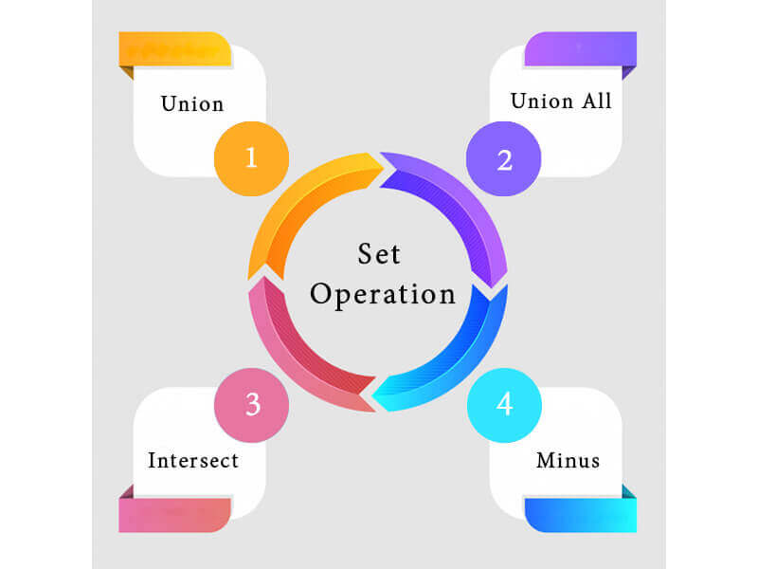
Set Queries: (UNION, INTERSECT, and EXCEPT) Set Operation functions in SQL
The SQL Set operation is used to combine the two or more SQL SELECT statements.
Types of Set Operation

Slide 63
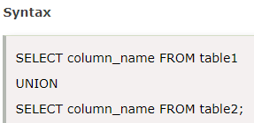
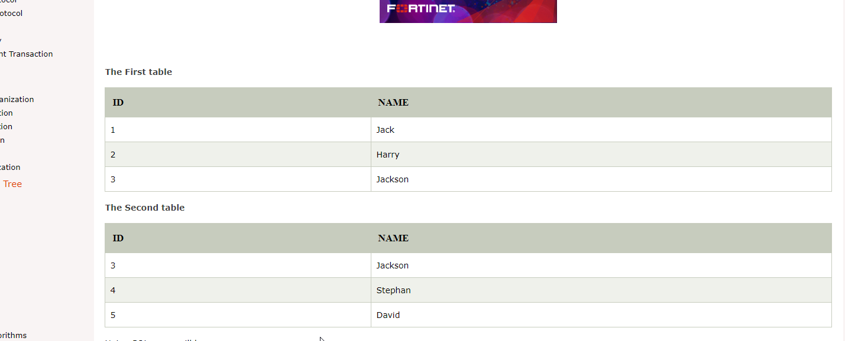
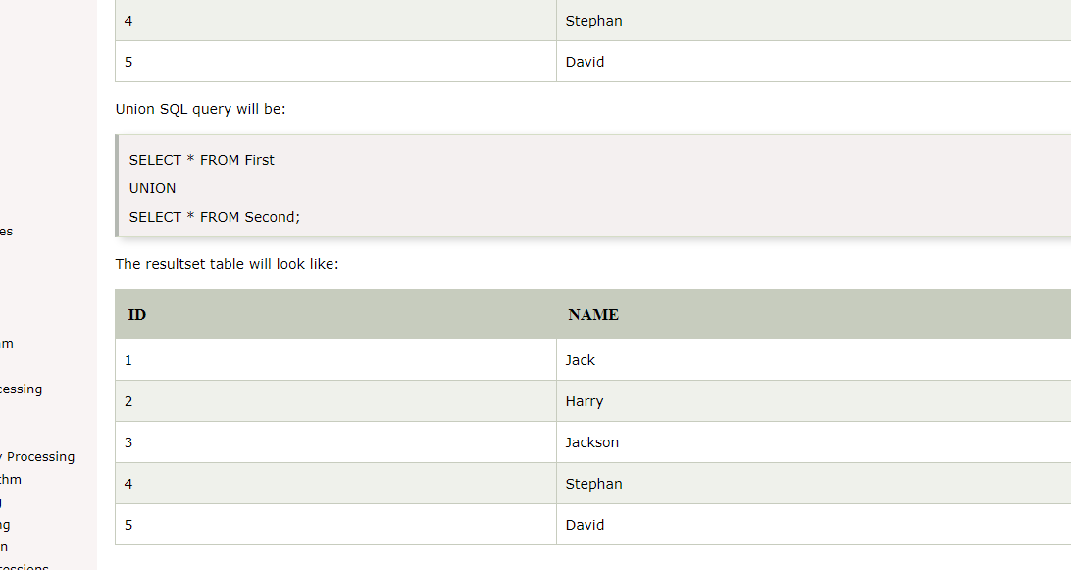
UNION Operation
UNION is used to combine the results of two or more SELECT statements.
However it will eliminate duplicate rows from its resultset.
In case of union, number of columns and datatype must be same in both the tables, on which UNION operation is being applied.

Slide 64
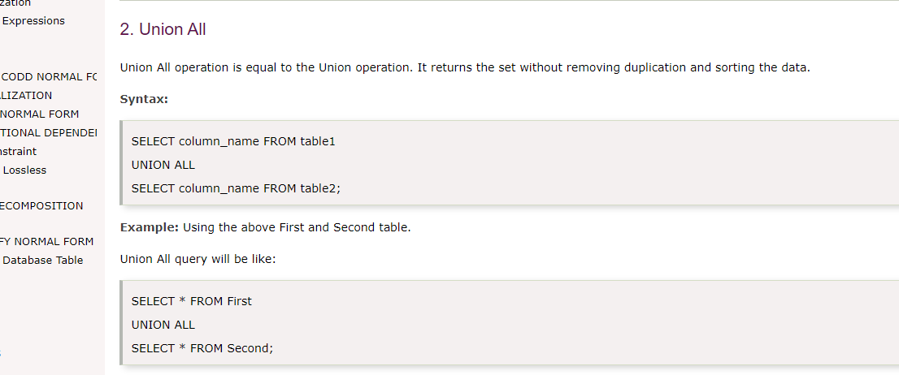
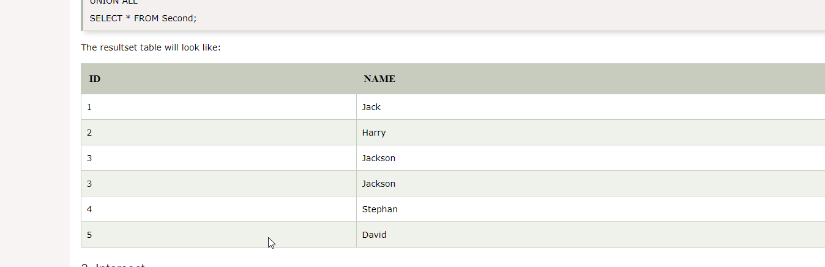
Union All
Union All operation is equal to the Union operation. It returns the set without removing duplication and sorting the data.

Slide 65
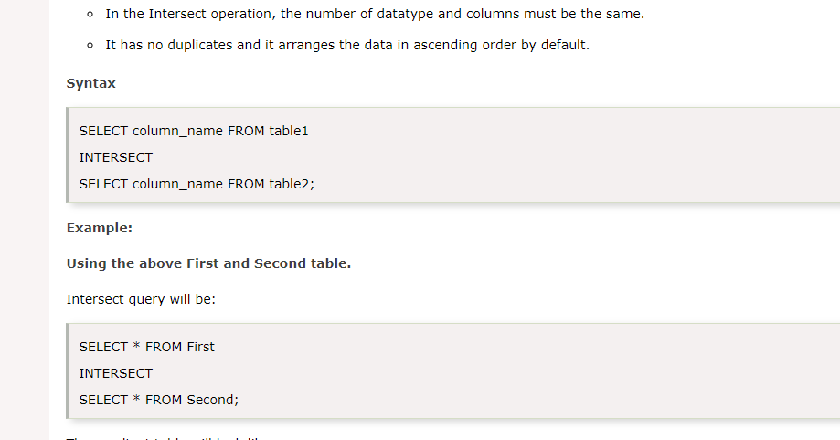
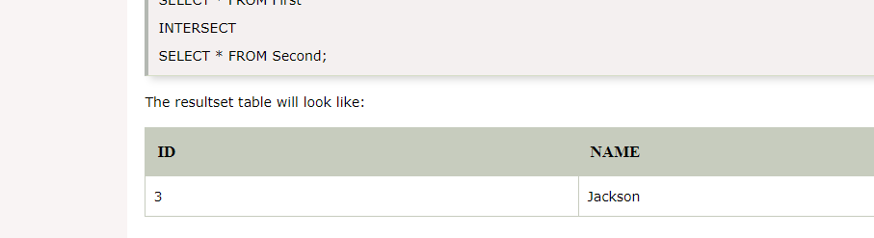
Intersect
It is used to combine two SELECT statements. The Intersect operation returns the common rows from both the SELECT statements.
In the Intersect operation, the number of datatype and columns must be the same.
It has no duplicates and it arranges the data in ascending order by default.

Slide 66
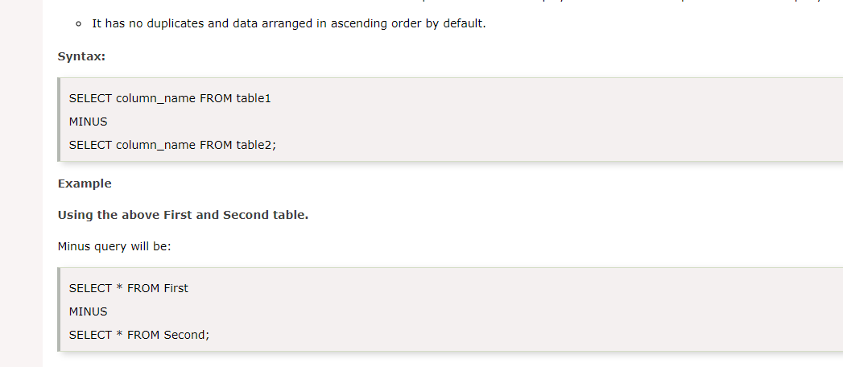
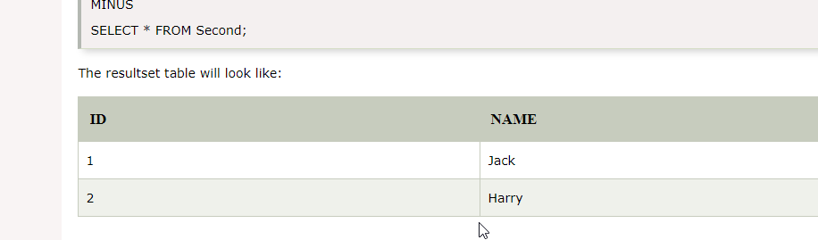
Except
It combines the result of two SELECT statements. Minus operator is used to display the rows which are present in the first query but absent in the second query.
It has no duplicates and data arranged in ascending order by default.

Slide 67
Subquery
Subquery can be simply defined as a query within another query. In other words we can say that a Subquery is a query that is embedded in WHERE clause of another SQL query.
Important rules for Subqueries
You can place the Subquery in a number of SQL clauses: WHERE clause, HAVING clause, FROM clause. Subqueries can be used with SELECT, UPDATE, INSERT, DELETE statements along with expression operator. It could be equality operator or comparison operator such as =, >, =, <= and Like operator.
A subquery is a query within another query. The outer query is called as main query and inner query is called as subquery.
The subquery generally executes first, and its output is used to complete the query condition for the main or outer query.
Subquery must be enclosed in parentheses.
Subqueries are on the right side of the comparison operator.
ORDER BY command cannot be used in a Subquery. GROUPBY command can be used to perform same function as ORDER BY command.
Use single-row operators with singlerow Subqueries. Use multiple-row operators with multiple-row Subqueries.

Slide 68
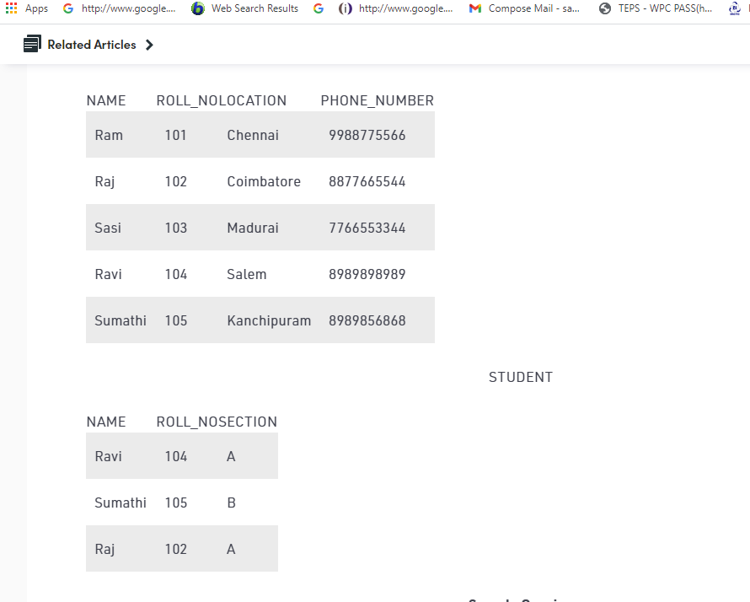
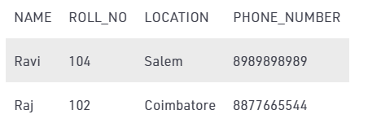
Subqueries with SELECT statement
Syntax
SELECT column_name FROM table_name WHERE column_name expression operator ( SELECT COLUMN_NAME from TABLE_NAME WHERE ... );
Select NAME, LOCATION, PHONE_NUMBER from DATABASE WHERE ROLL_NO IN (SELECT ROLL_NO from STUDENT where SECTION=’A’);

Slide 69
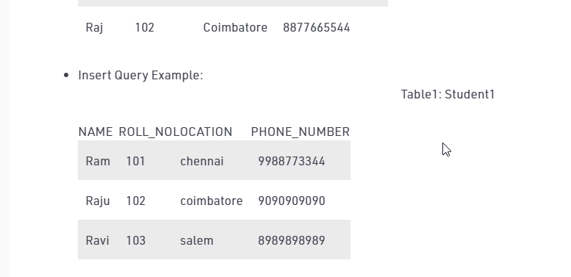

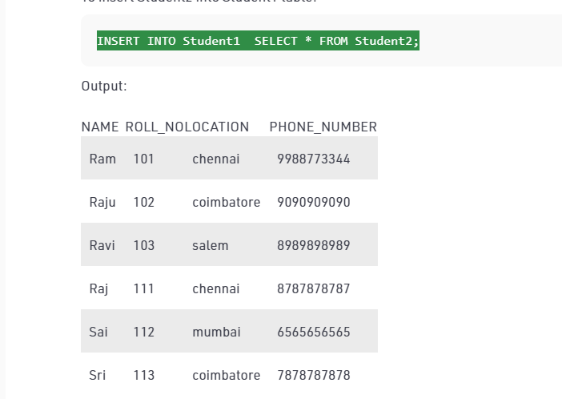
Subqueries with the INSERT Statement
Subqueries also can be used with INSERT statements.
The INSERT statement uses the data returned from the subquery to insert into another table.
The selected data in the subquery can be modified with any of the character, date or number functions.
INSERT INTO Student1 SELECT * FROM Student2;

Slide 70
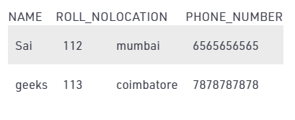
Subqueries with the UPDATE Statement
The subquery can be used in conjunction with the UPDATE statement. Either single or multiple columns in a table can be updated when using a subquery with the UPDATE statement.
To update name of the students to geeks in Student2 table whose location is same as Raju,Ravi in Student1 table
UPDATE Student2 SET NAME=’geeks’ WHERE LOCATION IN ( SELECT LOCATION FROM Student1 WHERE NAME IN (‘Raju’,’Ravi’));

Slide 71
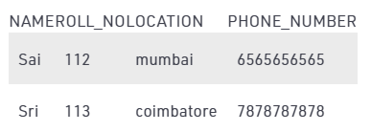
Subqueries with the DELETE Statement
The subquery can be used in conjunction with the DELETE statement like with any other statements mentioned above.
To delete students from Student2 table whose rollno is same as that in Student1 table and having location as Chennai.
DELETE FROM Student2 WHERE ROLL_NO IN ( SELECT ROLL_NO FROM Student1 WHERE LOCATION = ’chennai’);

Slide 72
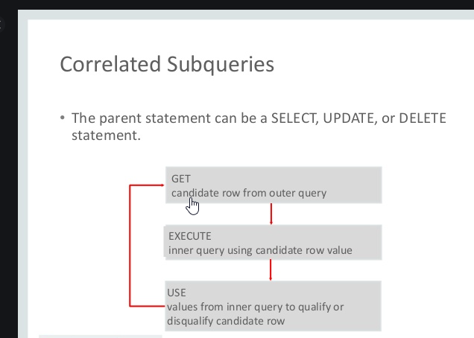
SQL Correlated Subqueries
Correlated subqueries are used for row-by-row processing. Each subquery is executed once for every row of the outer query.
A correlated subquery is evaluated once for each row processed by the parent statement. The parent statement can be a SELECT, UPDATE, or DELETE statement.
A correlated subquery is one way of reading every row in a table and comparing values in each row against related data.
It is used whenever a subquery must return a different result or set of results for each candidate row considered by the main query.

Slide 73
Nested Subqueries Versus Correlated Subqueries
With a normal nested subquery, the inner SELECT query runs first and executes once, returning values to be used by the main query.
A correlated subquery, however, executes once for each candidate row considered by the outer query. In other words, the inner query is driven by the outer query.
NOTE : You can also use the ANY and ALL operator in a correlated subquery.

Slide 74
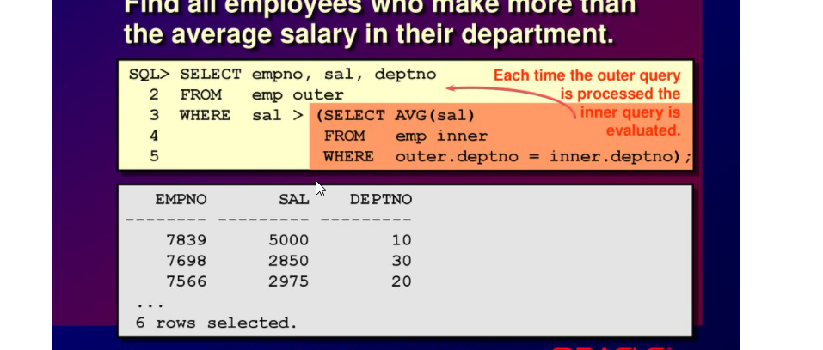
Correlated Subqueries with Select Statement
Find all the employees who earn more than the average salary in their department.

Slide 75
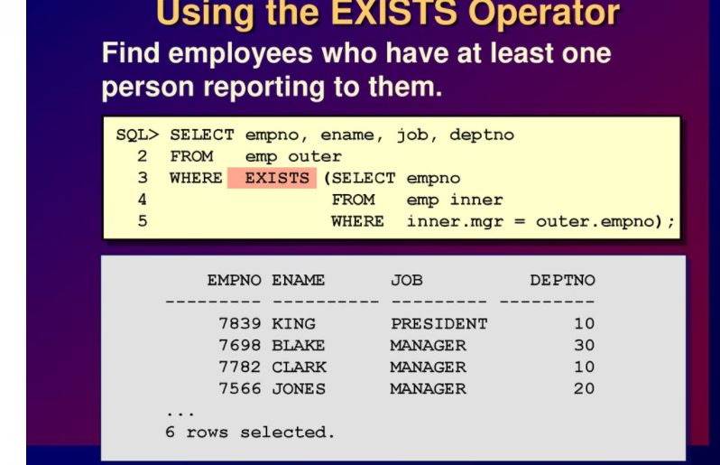
Using the Exists Operator
The EXISTS operator tests for existence of rows in the results set of the subquery.
If a subquery row value is found the condition is flagged TRUE and the search does not continue in the inner query, and if it is not found then the condition is flagged FALSE and the search continues in the inner query.
Find the employees who have at least one person reporting to them.

Slide 76
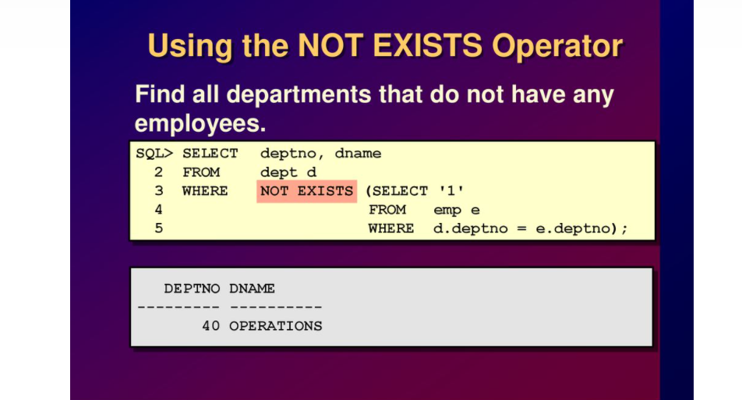
Using the Not Exists Operator
Find all the departments that do not have any employees

Slide 77
Data Manipulation Language (Modifying Data)
A DML statement is executed when you
Add new rows to a table
Modify existing rows in a table
Remove existing rows from a table

Slide 78
Add new rows to a table by using the INSERT statement.
1. INSERT INTO table VALUES(value1, value2,..);
Only one row is inserted at a time with this syntax.
List values in the default order of the columns in the table
Enclose character and date values within single quotation marks.
Insert a new row containing values for each column.
E.g.:
INSERT INTO Employee VALUES (‘ashok’, ‘16-mar-1998’, 30000);
2. INSERT INTO table(column1, column2,..)VALUES(value1, value2,..);
Rows can be inserted with NULL values either
by omitting column from the column list or
by specifying NULL in the value field.
E.g.:
INSERT INTO Employee (name, dob, salary) VALUES (‘ashok’, ‘16-mar-1998’, 30000);

Slide 79
3. INSERT INTO table_name1 SELECT column_name1, column_name2,….,column_nameN FROM table_name2;
INSERT INTO Employee_details SELECT name, dob FROM Exmployee;

Slide 80
CREATING DATABASE TABLE
CREATE – creates a new table in the database
Used to create a table by defining its structure, the data type and name of the various columns, the relationships with columns of other tables etc.
CREATE TABLE table_name (column_name1 data_type(size), column_name2 data_type(size),…., column_nameN data_type(size));
E.g.:
CREATE TABLE Employee(Name varchar2(20), DOB date, Salary number(6));

Slide 81
ALTER - Add a new attribute or Modify the characteristics of some existing attribute.
ALTER TABLE table_name ADD (column_name1 data_type (size), column_name2 data_type (size),….., column_nameN data_type (size));
E.g.:
ALTER TABLE Employee ADD (Address varchar2(20));
ALTER TABLE Employee ADD (Designation varchar2(20), Dept varchar2(3));

Slide 82
ALTER TABLE table_name MODIFY (column_name data_type(new_size));
E.g.:
ALTER TABLE Employee MODIFY (Name varchar2(30));
ALTER - dropping a column from the table
ALTER TABLE table_name DROP COLUMN column_name;
E.g.:
ALTER TABLE Student DROP COLUMN Age;

Slide 83
DROP - Deleting an entire table from the database.
DROP TABLE table_name;
E.g.:
DROP TABLE Employee
RENAME – Renaming the table
RENAME old_table_name TO new_table_name;
E.g.:
RENAME Employee TO Employee_details

Slide 84
TRUNCATE – deleting all rows from a table and free the space containing the table.
TRUNCATE TABLE table_name;
E.g.:
TRUNCATE TABLE Employee_details;

Slide 85
Tables: Create Table
An SQL relation is defined using the create table command:
create table r (A₁ D₁, A₂ D₂, ..., A_{n} D_{n}, (integrity-constraint₁), ..., (integrity-constraint_{k}))
r is the name of the relation
each A_{i} is an attribute name in the schema of relation r
D_{i} is the data type of values in the domain of attribute A_{i}
Example:
create table instructor ( ID char(5), name varchar(20), dept_name varchar(20), salary numeric(8,2))

Slide 86
Integrity Constraints in Create Table
not null
primary key (A₁, ..., A_{n} )
foreign key (A_{m}, ..., A_{n} ) references r
Example:
create table instructor ( ID char(5), name varchar(20) not null, dept_name varchar(20), salary numeric(8,2), primary key (ID), foreign key (dept_name) references department);
primary key declaration on an attribute automatically ensures not null

Slide 87
And a Few More Relation Definitions
create table student ( ID varchar(5), name varchar(20) not null, dept_name varchar(20), tot_cred numeric(3,0), primary key (ID),
foreign key (dept_name) references department);
create table takes ( ID varchar(5), course_id varchar(8), sec_id varchar(8), semester varchar(6), year numeric(4,0), grade varchar(2),
primary key (ID, course_id, sec_id, semester, year) ,
foreign key (ID) references student, foreign key (course_id, sec_id, semester, year) references section);
Note: sec_id can be dropped from primary key above, to ensure a student cannot be registered for two sections of the same course in the same semester

Slide 88
create table course ( course_id varchar(8), title varchar(50), dept_name varchar(20), credits numeric(2,0),
primary key (course_id),
foreign key (dept_name) references department);

Slide 89
Updates to tables
Insert
insert into instructor values (‘10211’, ’Smith’, ’Biology’, 66000);
Delete
Remove all tuples from the student relation
delete from student
Drop Table
drop table r
Alter
alter table r add A D
where A is the name of the attribute to be added to relation r and D is the domain of A.
All exiting tuples in the relation are assigned null as the value for the new attribute.
alter table r drop A
where A is the name of an attribute of relation r
Dropping of attributes not supported by many databases.

